Slide 1
Project-2
Kiran gavini
Student Id-16227237

Slide 2
Task1
FiRST DATA SET is divided into different test, training and validation data.
Different values of Spread and GOAL are taken to check performance and mse.
CODE:
load('P.mat');
load('T.mat');
[trainP,valP,testP,trainInd,valInd,testInd]=dividerand(P,0.6,0.2,0.2);
[trainT,valT,testT]=divideind(T,trainInd,valInd,testInd);
GOAL=0.5; % Goal value is changed in between 0.1 and 0.5

Slide 3
for SPREAD1=10:3:150; % Considering different values of spread
net1=newrbe(trainP,trainT,SPREAD1);
y1v=sim(net1,valP);
mse1v=mse(y1v-valT);
if (mse1v <= 0.5)
display(SPREAD1)
display(mse1v)
break
end
end
for SPREAD2=10:3:150;
net2=newrb(trainP,trainT,GOAL,SPREAD2);
y2v=sim(net2,valP);
mse2v=mse(y2v-valT);
if (mse2v <= 0.5)
display(SPREAD2)
display(mse2v)
break
end
end

Slide 4
Results for validation error for different GOAL and SPREAD for RB Net
 | RB | RB | RB | RB | RB
GOAL | 0.1 | 0.2 | 0.3 | 0.4 | 0.5
SPREAD2 | 25 | 22 | 19 | 19 | 19
MSEV | 0.4351 | 0.44 | 0.4528 | 0.4935 | 0.4957
PERFORMANCE | 0.175176 | 0.20987 | 0.321981 | - | -
As we increase goal values, the values of spread and mse are changing randomly but performance of system
is constantly increasing as we increase the goal. The values of spread are decreasing as we increase goal with increase in MSE.

Slide 5
Test MSE Code:
y1T=sim(net1,testP); % RBE
mse1T=mse(y1T-testT);
if (mse1T <= 0.5)
display(SPREAD1)
display(mse1T)
break
end
y2T=sim(net2,testP); %RB
mse2T=mse(y2T-testT);
if (mse2T <= 0.5)
display(SPREAD2)
display(mse2T)
break
end
 | RBE | RB
Goal | 0.5 | 0.5
Spread | 34 | 34
MSE | 0.4927 | 0.4927

Slide 6
function [p]=confmatrix(x,y)
for i=1:length(x)
if (x(i)>=0);
x(i)=1;
else
x(i)=-1;
end;
end;
TP=0;
FN=0;
FP=0;
TN=0;
for i=1:length(x)
if(y(i)==1 && x(i)==1)
TP=TP+1;
elseif(y(i)==1&& x(i)==-1)
FP=FP+1;
elseif(y(i)==-1&& x(i)==1)
FN=FN+1;
elseif(y(i)==-1&& x(i)==-1)
TN=TN+1;
end;
end;
FAR= FP/(TN+FP);
GAR= TP/(TP+FN);
FRR= FN/(TP+FN);
GRR= TN/(TN+FP);
p=[GAR,FAR;FRR,GRR];
y1v= sim(net1,valP); %net1= RBE
y1Tr= sim(net1,trainP);
y1T=sim(net1,testP);
c=confmatrix(y1v,valT); % Validation
c1=confmatrix(y1Tr,trainT); %Test
c2=confmatrix(y1T,testT); %Training
y2v=sim(net2,valP); %net2=RB
y2Tr=sim(net2,trainP);
y2T=sim(net2,testP);
c3=confmatrix(y2v,valT); %Validation
c4=confmatrix(y2Tr,trainT); %Test
c5=confmatrix(y2T,testT); %Training

Slide 7
Confusion Matrix
RBE
RB
Validation
Validation
0.7209 | 0.1690
0.2791 | 0.8310
0.6935 | 0
03065 | 1
Test
Test
1 | 0
0 | 1
0.7613 | 0.0430
0.2387 | 0.9570
Training
Training
0.7907 | 0.1268
0.2093 | 0.8732
0.7222 | 0.0667
0.2778 | 0.9333

Slide 8
Different Goal and Spread for Validation MSE are taken and plotted in the table.
Test MSE and Confusion matrix is specified in the above slides.

Slide 9
Task2
RBE(Validation,Test,Trianing):
roc=ezroc3((y1v+1)/2,(valT+1)/2,2,'ROC',1);
roc1=ezroc3((y1T+1)/2,(testT+1)/2,2,'ROC',1);
roc2=ezroc3((y1Tr+1)/2,(trainT+1)/2,2,'ROC',1);
RB(Validation,Test,Training):
roc3= ezroc3((y2v+1)/2,(valT+1)/2,2,'ROC',1);
roc4= ezroc3((y2T+1)/2,(testT+1)/2,2,'ROC',1);
roc5=ezroc3((y2Tr+1)/2,(trainT+1)/2,2,'ROC',1);

Slide 10
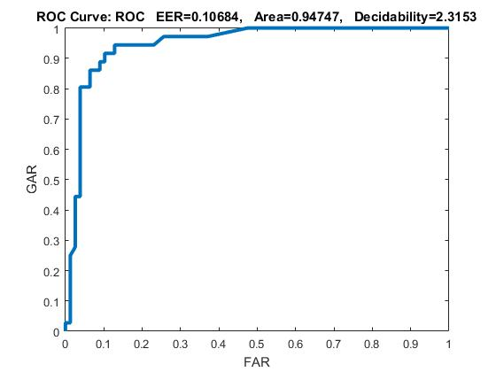
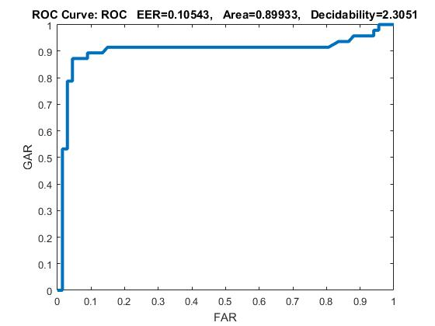
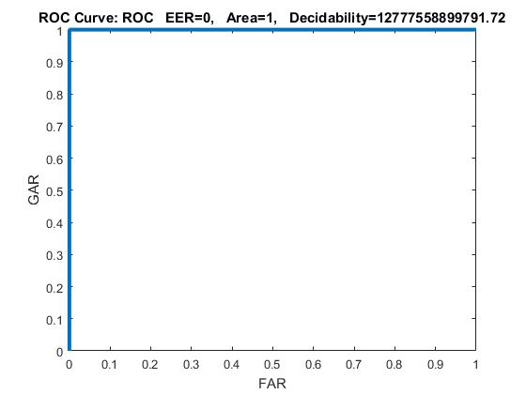
Validation RBE
Test RBE
Train RBE

Slide 11
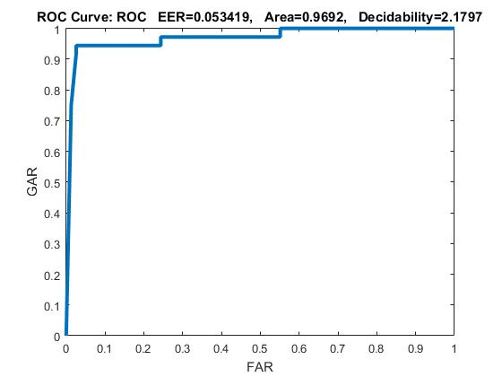
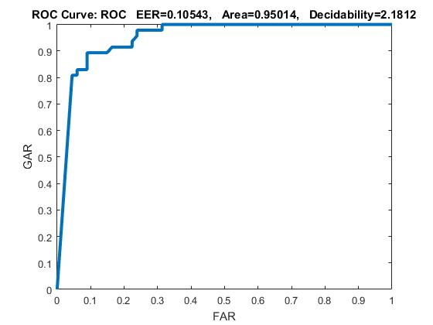
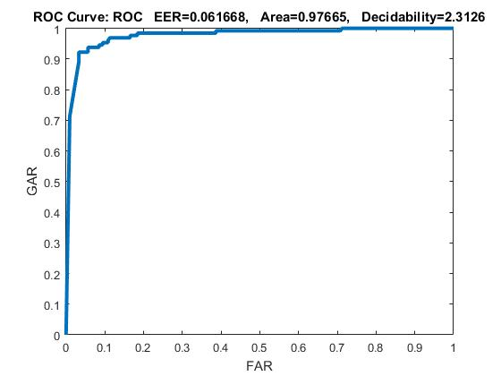
Validation RB
Test RB
Train RB

Slide 12
The graphs for RBE and RB are plotted according to ezroc function for Validation,Test and Training sets. Training graph of RBE
has 100% Area under the curve and these observations change randomly for each iteration based on different spread values
used in for for loop. The graphs are plotted between GAR and FAR.

